Slide 1
Section-4 – Personalized Marketing
Chapter-11 Retaining Customers

Slide 2
Introduction
As customers have more options for similar content to consume or similar products and services to shop for, it has become more difficult for many businesses to retain their customers and not lose them to other competitors.
As the cost of acquiring new customers is typically higher than that of retaining and keeping existing customers, customer churn is becoming more and more of a concern than ever before.
In order to retain existing customers and not lose them to competitors, businesses should not only try to understand their customers and their customers' needs and interests, but they should also be able to identify which customers are highly likely to churn and how to retain these customers at churn risk.

Slide 3
Introduction
In this chapter, discuss customer churn and how it hurts businesses, as well as how to retain existing customers.
Also discuss some of the common reasons for customers leaving businesses and look at how data science can help reduce the risk of losing customers.
As a way of predicting customer churn, learn about what an artificial neural network model is and its applications in different areas, as well as how can build one using Python and R.
In this chapter, cover the following topics:
Customer churn and retention
Artificial neural networks
Predicting customer churn with Python
Predicting customer churn with R

Slide 4
Customer churn and retention
Customer churn is when a customer decides to stop using services, content, or products from a company.
As discussed, in Exploratory Analysis for Customer Behavior, customer analytics, it is much less expensive to retain existing customers than to acquire new customers, and the revenue from repeat customers is typically higher than that from new customers.
In competitive industries, where a business faces many competitors, the cost of new customer acquisition is even higher, and retaining existing customers becomes more important for such businesses.
There are many reasons behind customers leaving a business.
Some of the common reasons why customers churn are poor customer service, not finding enough value in the products or services, lack of communications, and lack of customer loyalty.
The first step to retaining these customers is to monitor customer churn rates over time.
If the churn rate is generally high or is increasing over time, then it will be a good idea to dedicate some resources to improving customer retention.

Slide 5
Customer churn and retention
In order to improve the customer retention rate, the top priority should be to understand the customer better.
You can survey customers who have already churned to understand why they left.
You can also survey existing customers to understand what their needs are and what their pain points are.
A data science and data analytics approach would be to look into the data.
For example, you can look at customers' web activity data and understand where they spend the most time, whether there were errors on the pages that they were looking at, or whether their search results did not return good content.
You can also look into the customer service call logs to understand how long their wait time was, what their complaints were, and how their issues were handled.
Conducting deep analyses on these data points can reveal the problems that a business is facing in retaining its existing customers.

Slide 6
Customer churn and retention
When analyzing customer churn, also utilize some of the topics discussed in this book.
Apply, Product Analytics, and Recommending the Right Products, to understand which products serve the customer’s needs and interests the best, and recommend the right products so that can deliver more personalized content.
Also use Exploratory Analysis for Customer Behavior, and Data-Driven Customer Segmentation, to understand the customer behavior better and the different segments of customers.
Another way is to build a machine learning model that can predict which customers are likely to churn and target and retain these specific customers that are at higher risk of churn.
In the following sections, discuss how to build a neural network model to identify those customers with a higher risk of churn for customer retention.

Slide 7
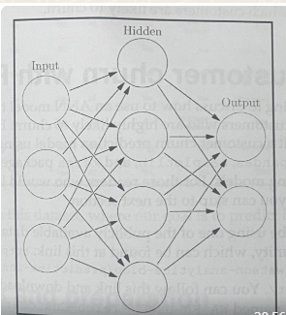
Artificial neural networks
The artificial neural network (ANN) model is a machine learning model that is inspired by how a human brain functions.
Recent successful applications of ANN models in image recognition, voice recognition, and robotics have proven their predictive power and usefulness in various industries.
This is a type of ANN model where the number of layers between the input and output layers is large.
It is best explained with the following diagram:

Slide 8
Artificial neural networks
This diagram shows a simple case of an ANN model with one hidden layer.
The circles in this diagram represent artificial neurons or nodes, which model those neurons in human brains.
The arrows represent how signals are transmitted from one neuron to another.
As this diagram suggests, an ANN model learns by finding the patterns or the weights of signals from each input neuron to the neuron in the next layer, which best predicts the output.
The specific type of ANN model that will be experimenting with in the following programming exercises is a multilayer perceptron (MLP) model.
Simply put, an MLP model is a neural network model that has at least one or more hidden layers of nodes.
Including one layer for the input and another layer for the output, the MIP model consists of at least three or more layers of nodes.
The diagram shows the simplest case of an MLP model, where there is only one hidden layer.

Slide 9
Artificial neural networks
ANN models can be utilized in many areas of marketing.
Using neural network models by BrainMaker, Microsoft increased its direct mail response rate from 4.9% to 8.2%.
This helped Microsoft to bring in the same amount of revenue for 35% less cost.
Similarly, for the marketing engagement prediction problems discussed in Chapter 8, Predicting the Likelihood of Marketing Engagement, can be used neural network models, instead of random forest models.
Also use neural network models for the customer segmentation problems discussed in Chapter 10, Data-Driven Customer Segmentation.
In the following programming exercises, discuss how can use ANN models to predict which customers are likely to churn.

Slide 10
Predicting customer churn with Python
In this section, discuss how to use an ANN model to predict the customers at the risk of leaving, or customers who are highly likely to churn.
By the end of this section, built a customer churn prediction model using an ANN model.
Using the pandas, matplotlib, and keras packages to analyze, visualize, and build machine learning models.
Using one of the publicly available datasets from the IBM Watson Analytics community, named WA_Fn-UseC_-Telco-Customer-Churn. xlsx.
Load it into Jupyter Notebook by running the following command:
import pandas as pd
df = pd. read_excel ('WA_En-UseC_-Telco-Customer-Churn.xlsx')

Slide 11
Data analysis and preparation
There are a few things to do before start building machine learning models.
In this section, transform continuous variables that have monetary values and encode the target variable, Churn, as well as other categorical variables.
To do so, perform the following steps:
1. Target variable encoding: The target variable, Churn, has two values: Yes and No.
Encode these values as 1 for Yes and 0 for No.
df ['Churn'] = df ['Churn'] .apply (lambda x: 1 if x == 'Yes' else 0)
To get the overall churn rate, simply run the following code:
df [' Churn' ]. mean ()
The output of this code is around 0.27, which suggests that about 27% of customers have churned.
A 27% churn rate is not a small number; rather, it is high enough for a business to worry about the overall customer churn and come up with a solution to retain these customers.

Slide 12
Data analysis and preparation
2. Handling missing values in the TotalCharges column: Since there are only 11 records with missing TotalCharges values, simply ignore and drop those records with missing values.
Take a look at the following code:
df ['TotalCharges'] = df['TotalCharges']. replace(' ',np. nan).astype (float)
df = df. dropna ( )
Simply replace the blank space values with nan values.
Then, drop all the records with nan values by using the dropna function.

Slide 13
Data analysis and preparation
3. ransforming continuous variables: The next step is to scale the continuous variables.
Take a look at the following summary statistics for continuous variables:
df [['tenure', 'MonthlyCharges', 'TotalCharges’ ]] .describe ()
From the summary statistics, the three tenure, MonthlyCharges, and TotalCharges continuous variables all have different scales.
The tenure variable, ranges from 1 to 72, while the TotalCharges variable, ranges from 18. 8 to 8684. 8.
ANN models typically perform better with scaled or normalized features.
The following code for normalizing these three features and result is as follows

Slide 14
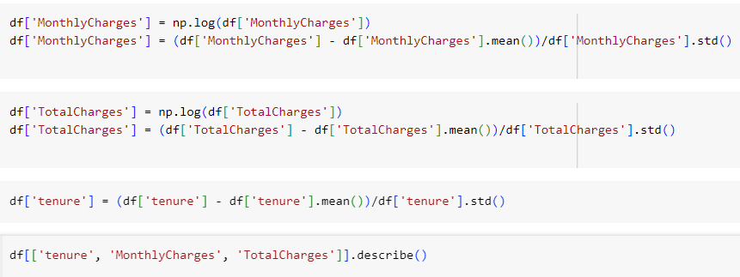
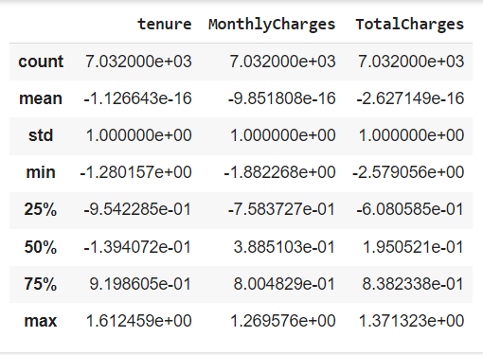
Data analysis and preparation

Slide 15
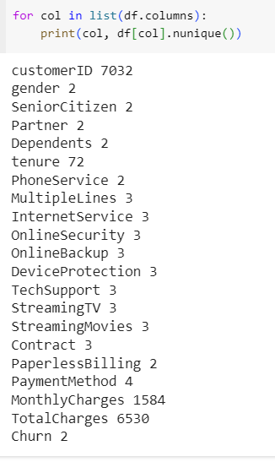
Data analysis and preparation
4. One-hot encoding categorical variables: There are many categorical variables in the data.
Let's first take a look at the number of unique values each column has.

Slide 16
Data analysis and preparation
As this output suggests, there are 7032 unique customer IDs, 2 unique genders, 3 unique values for MultipleLines, and 6530 unique values for TotalCharges.
We have handled the tenure, MonthlyCharges, and TotalCharges variables, in the previous step, so we are going to focus on those variables with 2 to 4 unique values.
Let's take a look at the distributions of some of these categorical variables.
First, to view the distribution of the data between males and females, use the following code for visualization:
df. groupby ('gender'). count () ['customerID']. plot (kind='bar', color='skyblue', grid=True, figsize=(8, 6), title= 'Gender'plt. show ()

Slide 17
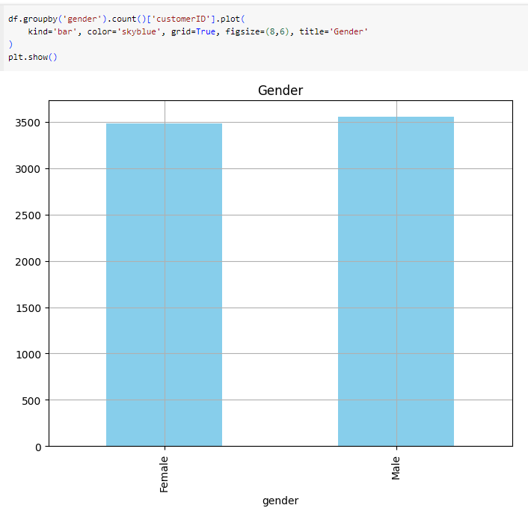
Data analysis and preparation

Slide 18
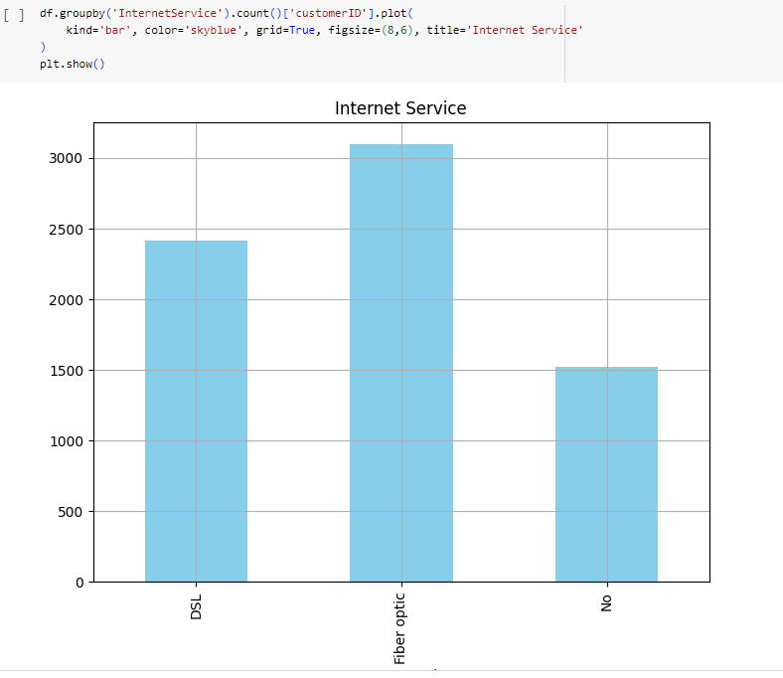
Data analysis and preparation
From this bar plot, the distribution of the data across different genders is roughly equally distributed.
Use the same code to view the distribution of the data across different values of Internet Service and PaymentMethod.
Take a look at the following plots:

Slide 19
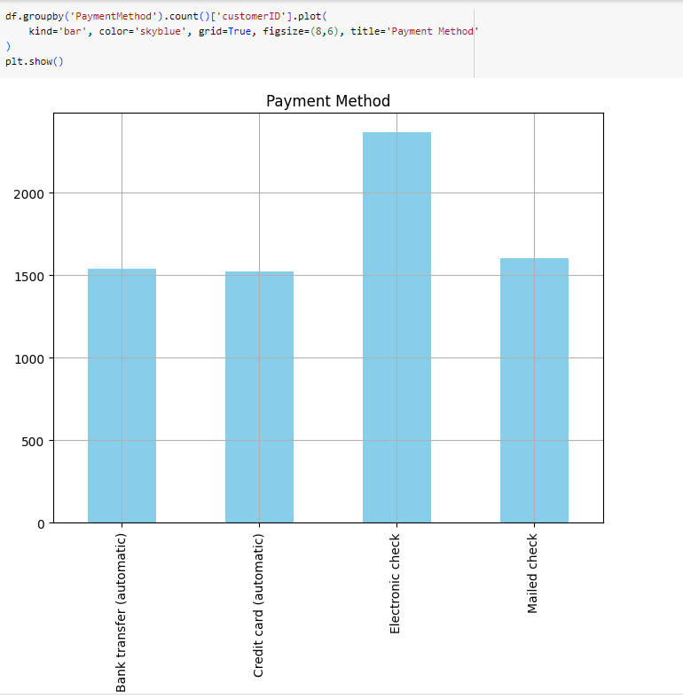

Slide 20
Data analysis and preparation
The first plot shows the distribution of the data across three different categories of the InternetService variable, and the second plot shows the distribution of the data across four different categories of the PaymentMethod variable.
From these plots, easily visualize and understand what the distributions of categorical variables look like using bar plots.
Now, apply one-hot encoding for these categorical variables use the following code
Use the get_dummies function in the pandas package to create dummy variables for each categorical variable.
Then, concatenate these newly created dummy variables back to the sample_set variable, which will be used for training models in the following section.
The results are shown in the following output:

Slide 21
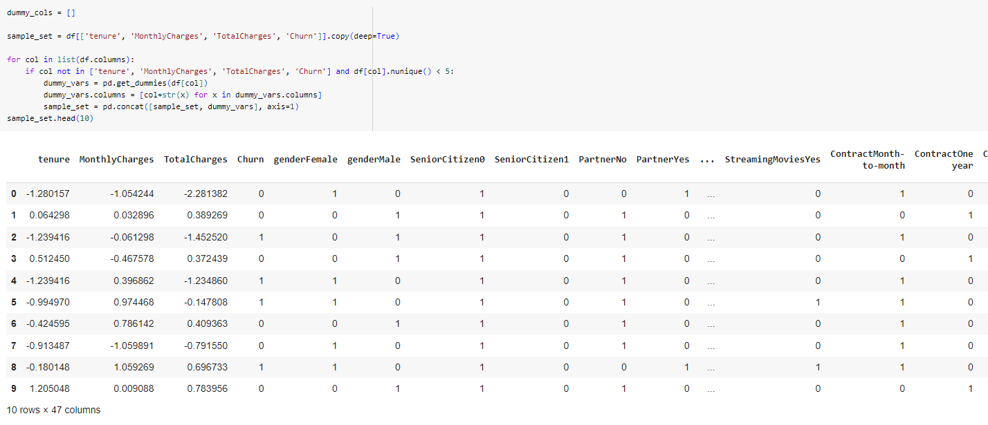
Data analysis and preparation

Slide 22
ANN with Keras
For building ANN models in Python, use keras package, which is a high-level neural networks library.
Before use this package for building ANN models, install two packages: tensorflow and keras.
The keras package uses tensorflow as a backend for building neural network models, so install tensorflow first.
Install these two packages using the following pip commands in your Terminal:
pip install tensorflow
pip install keras
Once installed these two packages, finally start building neural network models.

Slide 23
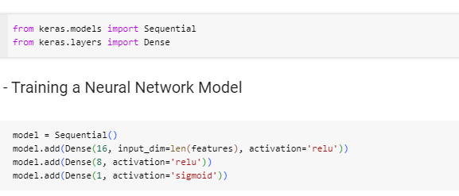
ANN with Keras
In this exercise, build a neural network model with one hidden layer.
Take a look at the following code first:

Slide 24
ANN with Keras
First, using a Sequential model here, which is the type of model where the layers are stacked linearly and looks similar to the diagram as saw in the earlier section about the MLP model.
The first layer is an input layer, where input_dim is simply the number of features or columns in the sample set and the number of output units is 16.
Using the relu activation function for this input layer.
Then, in the hidden layer, the number of output units is 8 and the activation function to be used in relu.
Lastly, the output layer has one output unit, which is the probability of customer churn, and use the sigmoid activation function in this layer.
Use different numbers of output units and activation functions for your exercise.

Slide 25
ANN with Keras
The final step to build a neural network model with the keras package is to compile this model.
Use the adam optimizer, which is one of the most commonly and frequently used optimization algorithms.
Since our target variable is binary, using binary_crossentropy as the loss function.
Lastly, this model use the accuracy metric to evaluate model performance during training.
Before start training this neural network model, split our sample set into train and test sets.
Use the train_test_split function of the scikit-learn package.
For our exercise, we will use 70% of the sample set for training and 30% for testing.

Slide 26
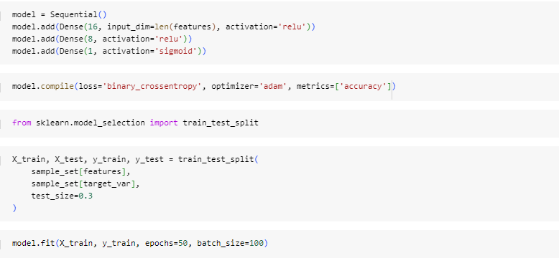
ANN with Keras

Slide 27
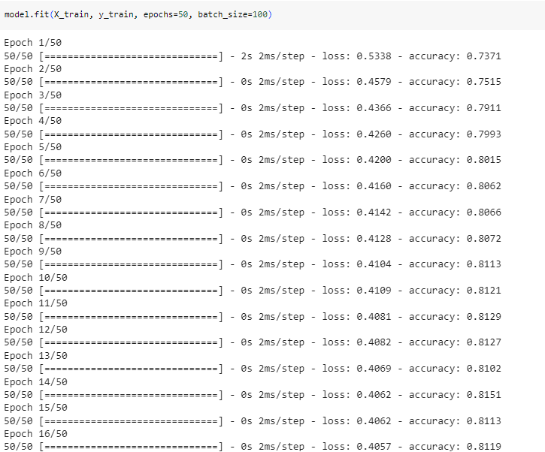
ANN with Keras

Slide 28
ANN with Keras
Here, we are using 100 samples as batch_size, from which the model is going to learn to predict each time, and 50 as the number of epochs, which is the number of complete passes through the entire training set.
From this output, loss typically decreases and the accuracy (acc) improves in each epoch.
However, the rate of model performance improvement decreases over time.
As you can see from this output, there are big improvements in the loss and accuracy measures in the first few epochs and the amount of performance gain decreases over time.
You can monitor this process and decide to stop when the amount of performance gain is minimal.

Slide 29
Model evaluations
We are going to look at the overall accuracy, precision, and recall, as well as the receiver operating characteristic (ROC) curve and area under the curve (AUC).
First, take a look at the following code for computing accuracy, precision, and recall:
From this output, the accuracy of predicting whether a customer will churn or not in the test set is about 0. 79, suggesting the model is correct roughly about 80% of the time.
The out-of-sample precision suggests that the model is correct about 66% of the time and it predicts that the customer is going to churn, and the out-of-sample recall suggests that the model captures roughly 52% of the churn cases.

Slide 30
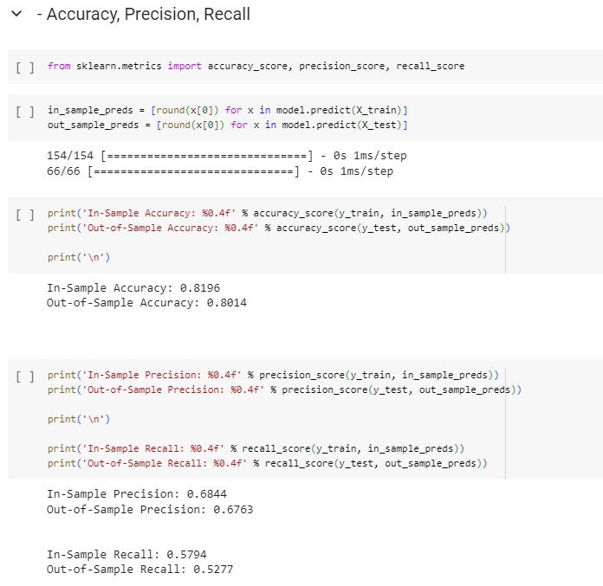
ANN with Keras

Slide 31
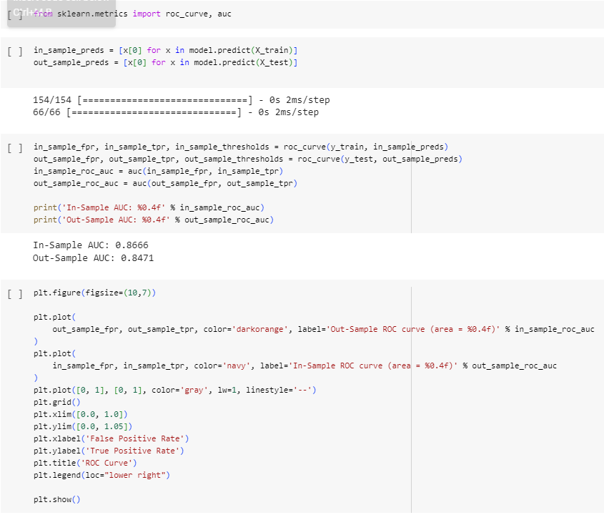
ANN with Keras

Slide 32
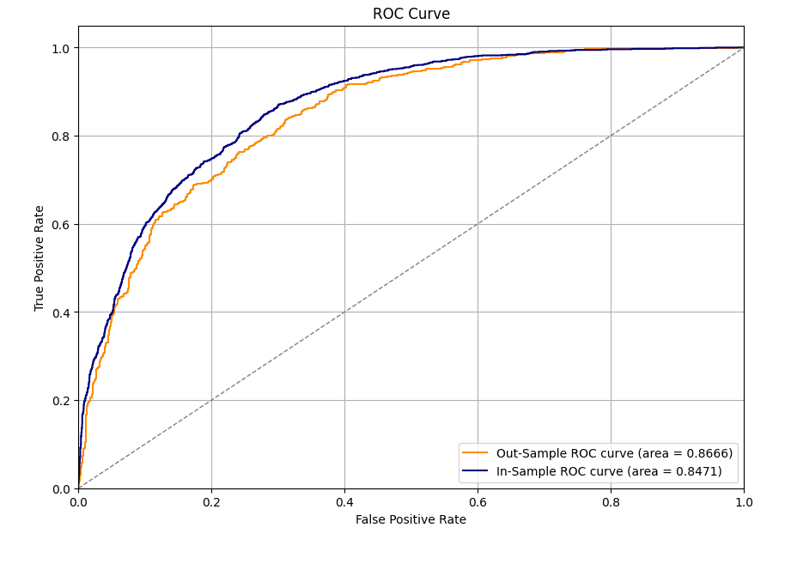
ANN with Keras

